Slide 1

CARMA:
A Social Driving Experience
John Jessen
Minh Ly
David Kamm
Rob Balian

Slide 2

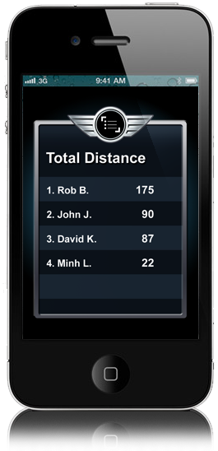
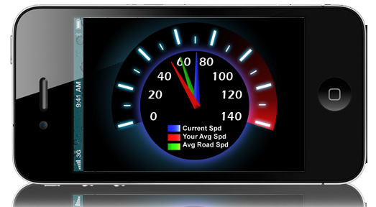
How do we do this?
Gather
Analyze
Engage

Slide 3

Gather
Acceleration
Speed
Compass Heading
Longitude
Stoplight Detection
Latitude

Slide 4
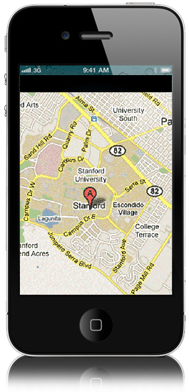
Analyze
Routes
Put Data into
Context

Slide 5
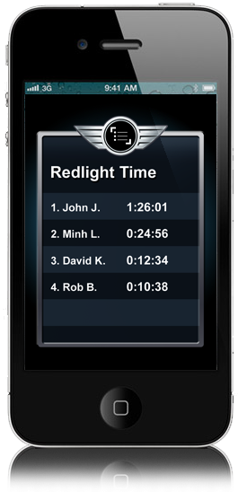
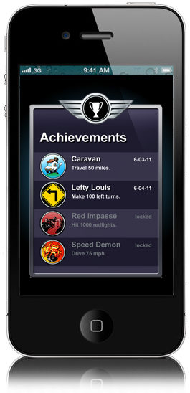
Engage

Slide 6

The Road Ahead
Good Driver Discount

Slide 7
Carma: Fin

